Slide 1
JSP Directive Elements

Slide 2
JSP Implicit object
In this module we will see below topics
JSP page directive
JSP include directive
JSP taglib directive

Slide 3
JSP Page Directive
Directive Tag provides special instruction to Web Container during the page translation. It is of three types: page, include and taglib.
The Syntax is:
<%@ page attributeName=”value” %>
To give the information, page directive comes with 14 attributes. Each attribute gives a special processing information to the container.

Slide 4
JSP Page Directive
JSP Page Directive – Attribute list
ATTRIBUTE NAME
IMPORT | This attribute is equivalent to Java import. Used to import packages in JSP coding.
CONTENTTYPE | Sets the content type to the JSP page. Default is text/html.
EXTENDS | It is very less used attribute. It specifies what super class, the generated servlet should extend.
INFO | Used to describe the JSP file like when the Project started, Programmers involved etc.
BUFFER | Sets the buffer size, in kilobytes, used to send the output to the client. Default size is 8 kb.
ISTHREADSAFE | This attribute is equivalent to SingleThreadModel of Servlet. Default setting value is true which indicates the JSP is by default SingleThreadModel. If multithreaded environment is not required in JSP, set this attribute to false.
LANGUAGE | Sets the language used to write JSP code. Default is Java.
SESSION | Default value is true indicating the JSP code can make use of sessions and when set to false, container does not allow to create new sessions.
AUTOFLUSH | If the value is set to true, the buffer will be flushed out implicitly when the output (response) buffer is full. Raises exception when set to false to indicate buffer overflow.
ERRORPAGE | Sets the name of the error page to which error messages are to be sent, if raised in the JSP file.
ISERRORPAGE | It this attribute value is set to true, the JSP file displays the error message by creating excetption (one of implicit objects) object.
ISELIGNORED | Latest development in JSP is using Expression Language (EL). By default EL is enabled. When this attribute is set to true, container ignores EL in JSP code. Introduced with JSP 2.0.
ISSCRIPTINGENABLED | JSP code contains scriptlets, expressions and declarations. By default, this attribute is set to true and means these elements (non-EL) are recognized by the container. When set to false, if scriptlet etc. are used in code, the container raises translation-time error.

Slide 5
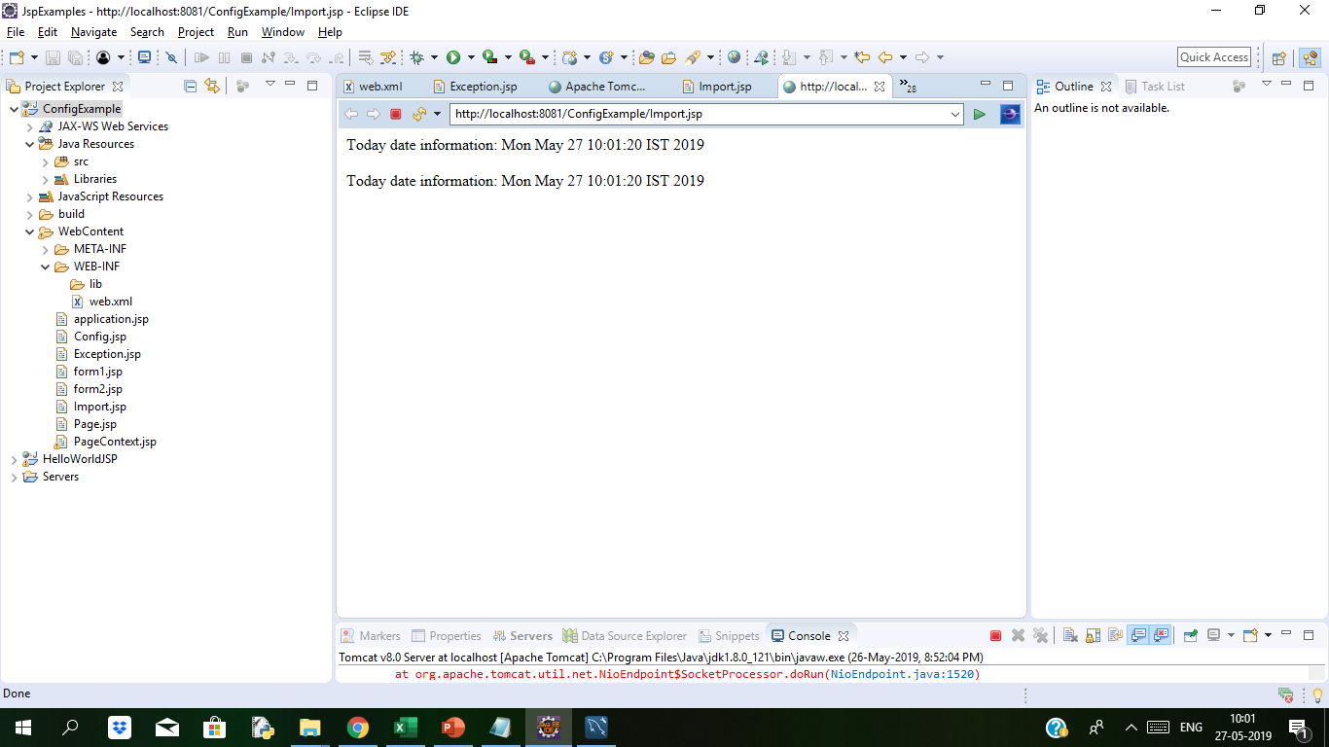
JSP page directive(import) Example Duration 10 min
<body>
<%@ page import="java.util.*" %><%-- this is import page directive --%>
<%! Date d1; %> <%-- this is declaration --%>
<% // this is scriptlet
d1 = new Date();
out.println("Today date information: " + d1);
%>
<br> <br>
Today date information: <%= d1 %><!-- this is expression -->
</body>
Import Directive:
JSP page directive supports. import JSP is used to import packages in JSP.
Example:
<%@ page import="java.util.List" %> : imports only one interface List
JSP import attribute gives a facility of importing multiple import directives in a single line. The above three lines can be substituted with a single line with single import as follows.
<%@ page import="java.util.*, java.net.*, java.io.*" %>
The packages are separated by commas.
Note: There is no semicolon at the end in the import statement.
We will see the example.
In the below code all the four, import directive, declaration, scriptlet and expression are used.

Slide 6
JSP page directive
extends
This attribute is used to inherit a class into JSP file.
Syntax of extends JSP
Example: <%@ page extends=“example.Test" %>
where example is the package name and Test is the class that is inherited. Now,Test class is available to the JSP file to use
The Servlet class generated by the containter extends Class HttpJspBase
extends attribute usage is very rare. JSP containers default behavior almost always suffices.
.

Slide 7
JSP Page Directive
Info
We can use info attribute to give some information or description about the JSP page like
1) when the project started
2) Programmers involved
3) functionality of the page etc.
This information is seen in the source code only.
This information is not forward to client as container ignores the information given in info attribute.
Syntax of info JSP attribute?
<%@ page info="some text" %> Example: <%@ page info="Project started on 01-08-2014" %>
we retrieve the information given as string return for info attribute with getServletInfo() method.

Slide 8

JSP Page Directive (Buffer)Example Duration: 5min
Buffer
This attribute is used to define the buffer size. JSP first writes the response data to the buffer and when the buffer is full, the data is sent to client.
When the PrintWriter object is closed with out.close(), the unfilled buffer is flushed to the client.
Using this page directive attribute, the buffer size can be increased or decreased or set to none (means no buffer is maintained).
If not set by the Programmer, the default buffer size is 8 KB.
Syntax: <%@ page buffer=”value”%>
We will see the example to explain how buffer works
Here The response is copied into the 32 KB buffer before sending to client.
If buffer is none,the response data is immediately written to outputstream of client. This kills performance and increases network traffic.
Below is jsp code
<%@ page buffer="32kb" %>
<html>
<head>
<title>Buffer directive example</title>
</head>
<body>
<h3>This page explains how buffer works</h3>
</body>
</html>

Slide 9
JSP Page Directive
isThreadSafe
This attribute takes boolean values of true or false indicating the JSP page can be safe in multithreaded environment or not. The default value is true.
Syntax of isThreadSafe JSP
<%@ page isThreadSafe="true" %>
1. isThreadSafe="true", creates multiple objects for the same JSP file when requested by multiple clients. Each client is served with a separate _jspService() method (with only one JSP file loaded).
2. isThreadSafe="false", allows the container to create one Servlet object for each client requesting the same JSP. Multiple clients will have multiple Servlet objects created by the container to honour all the clients.
Notes:
Note: Never end an expression with semicolon inside Expression Tag. Like this:
<%= (11*2); %>

Slide 10
JSP Page Directive
language
This attribute tells the container which language is being used to write the JSP page. Programmer declares the language with this attribute.
language JSP Syntax:
<%@ page language="java" %>
The default language is Java and for this reason Programmer never writes this attribute. In future, if the designers would like to give support for other language, then language attribute comes into usage. As on today, no other language is supported by JSP
Note: language="java" is case-sensitive.

Slide 11
JSP Page Directive
Session
JSP page creates session by default.
Sometimes we don’t require a session to be created in JSP, and hence, we can set this attribute to false in that case. The default value of the session attribute is true, and the session is created.
When it is set to false, then we can indicate the compiler to not create the session by default.
Syntax of session:
<%@ page session="true/false"%>
Here in this case session attribute can be set to true or false
Example:
<%@ page language="java" contentType="text/html; charset=ISO-8859-1“ session="false"%>
In the above example, session attribute is set to "false" hence we are indicating that we don't want to create any session in this JSP

Slide 12
JSP Page Directive
autoFlush
It takes boolean values of true or false.
It indicates the container to flush the data or not when the buffer gets filled to be sent to client.
If not set by the Programmer, the default value is true, indicating flushing is required.
When set to false, the autoFlush raises exception when the buffer is full.
Syntax: <%@ page autoFlush="true/false" %>
The autoflush is set to true when
It is the default value.
When the buffer is full, the data is flushed out to the output stream of the response object to send to client.
This is done by the container implicitly.
<%@ page autoFlush="true" %>

Slide 13
JSP Page Directive
ERRORPAGE
In JSP, the errorPage attribute of page directive is used to specify a web page which will be displayed as an error page for the current JSP page i.e. if there is an error while executing the current page). Syntax
<%@ page errorPage= “loginerror.jsp" %>
isErrorPage Attribute
In JSP, the isErrorPage attribute of page directive is used to specify whether the current page could be displayed as an error page for another JSP page. We could set the value of isErrorPage to either true or false.
Syntax
<%@ page isErrorPage= "true|false" %>

Slide 14
JSP Page Directive
isErrorPage = "true"
When isErrorPage is set to true, the current page is displayed in case an error appears in another JSP page.
When isErrorPage is set to true, the current page is displayed in case an error appears in another JSP page.
<%@ page isErrorPage= "true" %>
isErrorPage = "false"
By default, the isErrorPage attribute value is false, hence we don't have to set isErrorPage to false, in case if we don't want the current page to be displayed as an error appears for any JSP page.
To understand iserrorpage we will see the example.
We are setting a web page ErrorPage. Jsp as an error page for the current page StringLength.jsp executing the StringLength.jsp web page will throw an NullPointerException exception, which we read using JSP inbuilt exception object in ErrorPage.jsp.
<html>
<head>
<title>Calculate String Length</title>
</head>
<body>
<%
String str = null;
int length = str.length();
%>
Length of String is <%= length %>
</body>
</html>

Slide 15
JSP Config object Example
<?xml version="1.0" encoding="UTF-8"?>
<web-app xmlns:xsi="http://www.w3.org/2001/XMLSchema-instance" xmlns="http://xmlns.jcp.org/xml/ns/javaee" xsi:schemaLocation="http://xmlns.jcp.org/xml/ns/javaee http://xmlns.jcp.org/xml/ns/javaee/web-app_3_1.xsd" id="WebApp_ID" version="3.1">
<display-name>ConfigExample</display-name>
<servlet>
<description></description>
<display-name>Config</display-name>
<servlet-name>Config</servlet-name>
<servlet-class>test.Config</servlet-class>
</servlet>
<servlet-mapping>
<servlet-name>Config</servlet-name>
<url-pattern>/Config</url-pattern>
</servlet-mapping>
<welcome-file-list>
<welcome-file>index.html</welcome-file>
<welcome-file>index.htm</welcome-file>
<welcome-file>index.jsp</welcome-file>
<welcome-file>default.html</welcome-file>
<welcome-file>default.htm</welcome-file>
<welcome-file>Config.jsp</welcome-file>
</welcome-file-list>
</web-app>
<%@ page language="java" contentType="text/html;"%>
<!DOCTYPE html PUBLIC "-//W3C//DTD HTML 4.01 Transitional//EN" "http://www.w3.org/TR/html4/loose.dtd">
<html>
<head>
<meta http-equiv="Content-Type" content="text/html;">
<title>Config Object Example</title>
</head>
<body>
<% String servletName = config.getServletName();
out.println("Servlet Name is " + servletName);%>
</body>
</html>
After Executing on browser we can see the output as
Servlet Name is Config
Notes:
In web.xml we have mapping of servlets to the classes.
To get the name of the servlet in JSP, we can use config.getServletName, which will help us to get the name of the servlet.

Slide 16
JSP Application object Example Duration: 5 min
Application
Application object is an instance of javax.servlet.ServletContext and it is used to get the context information and attributes in JSP.
Application object is created by container one per application, when the application gets deployed.
Servletcontext object contains a set of methods which are used to interact with the servlet container.We can find information about the servlet container
We will see the below example to understand the application object example
<%@ page language="java" contentType="text/html; charset=ISO-8859-1" pageEncoding="ISO-8859-1"%>
<!DOCTYPE html PUBLIC "-//W3C//DTD HTML 4.01 Transitional//EN" "http://www.w3.org/TR/html4/loose.dtd">
<html>
<head>
<meta http-equiv="Content-Type" content="text/html; charset=ISO-8859-1">
<title>Application Object Example</title>
</head>
<body>
<% out.println(application.getContextPath()); %>
</body>
</html>
We will see the following output when we run on browser.
/ApplicationExample
Notes:
Note: Never end an expression with semicolon inside Expression Tag. Like this:
<%= (11*2); %>

Slide 17
JSP Session object Example Duration: 10 min
Session
The session is holding "httpsession" object.
Session object is used to get, set and remove attributes to session scope and also used to get session information
We will see the example to understand how session object works. Below is form1.jsp
form2.jsp
<%@ page language="java" contentType="text/html; charset=ISO-8859-1"
pageEncoding="ISO-8859-1"%>
<!DOCTYPE html PUBLIC "-//W3C//DTD HTML 4.01 Transitional//EN" "http://www.w3.org/TR/html4/loose.dtd">
<html>
<head>
<meta http-equiv="Content-Type" content="text/html; charset=ISO-8859-1">
<title>Session Object Example</title>
</head>
<body>
<% String name = (String)session.getAttribute("user");
out.println("User Name is " +name);
%>
</body>
</html>
<%@ page language="java" contentType="text/html;"%>
<!DOCTYPE html PUBLIC "-//W3C//DTD HTML 4.01 Transitional//EN" "http://www.w3.org/TR/html4/loose.dtd">
<html>
<head>
<meta http-equiv="Content-Type" content="text/html;">
<title>JSP session object</title>
</head>
<body>
<% session.setAttribute("user","admin"); %>
<a href="form2.jsp">Click here to get user name</a>
</body>
</html>

Slide 18
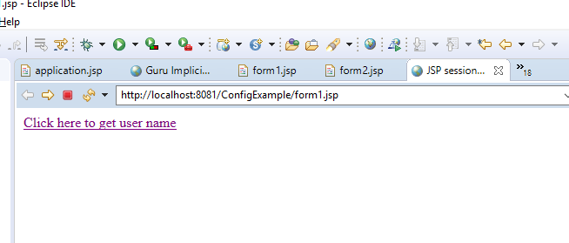
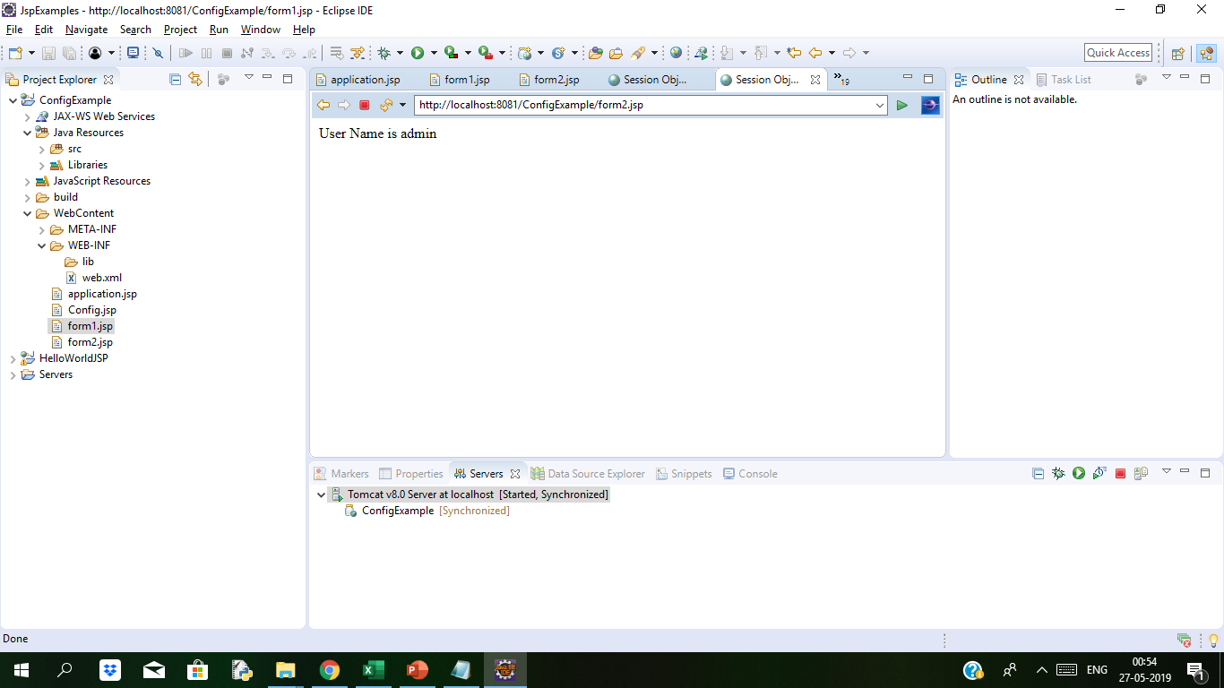
JSP Session object Example Duration:10 min
In form1.jsp we are setting the attribute user in the session variable, and that value can be fetched from the session in whichever jsp is called from that (form2.jsp).
We are getting the value of user attribute from session object and displaying that value
When we run on browser the above code, we get the following output:
We are calling another jsp on href in which we will get the value for attribute user which is set.
form2.jsp
Notes:
When we click on link given in form1.jsp then we are redirected to second jsp page, i.e (form2.jsp) page and we get the value from session object of the user attribute (form1.jsp).

Slide 19
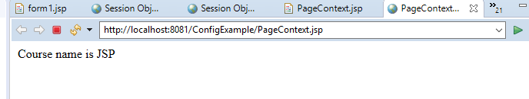
JSP pageContext object Example Duration 5 min
pageContext:
This object is of the type of pagecontext.
It is used to get, set and remove the attributes from a particular scope
Scopes are of 4 types:
Page
Request
Session
Application
we are setting the attribute using pageContext object, and it has three parameters:
Key
Value
Scope
We will observe the example how it works.
In the example the key is course and value is “JSP" while the scope is the page scope. Here the scope is "page" and it can get using page scope only.
We are getting the value of the attribute using pageContext
<%@ page language="java" contentType="text/html; charset=ISO-8859-1"
pageEncoding="ISO-8859-1"%>
<!DOCTYPE html PUBLIC "-//W3C//DTD HTML 4.01 Transitional//EN" "http://www.w3.org/TR/html4/loose.dtd">
<html>
<head>
<meta http-equiv="Content-Type" content="text/html; charset=ISO-8859-1">
<title>PageContextExample</title>
</head>
<body>
<% pageContext.setAttribute("course","JSP",pageContext.PAGE_SCOPE);
String name = (String)pageContext.getAttribute("course");
out.println("Course name is " +name);%>
</body>
</html>
When you execute the above code, you get the following output:
Course name is JSP

Slide 20
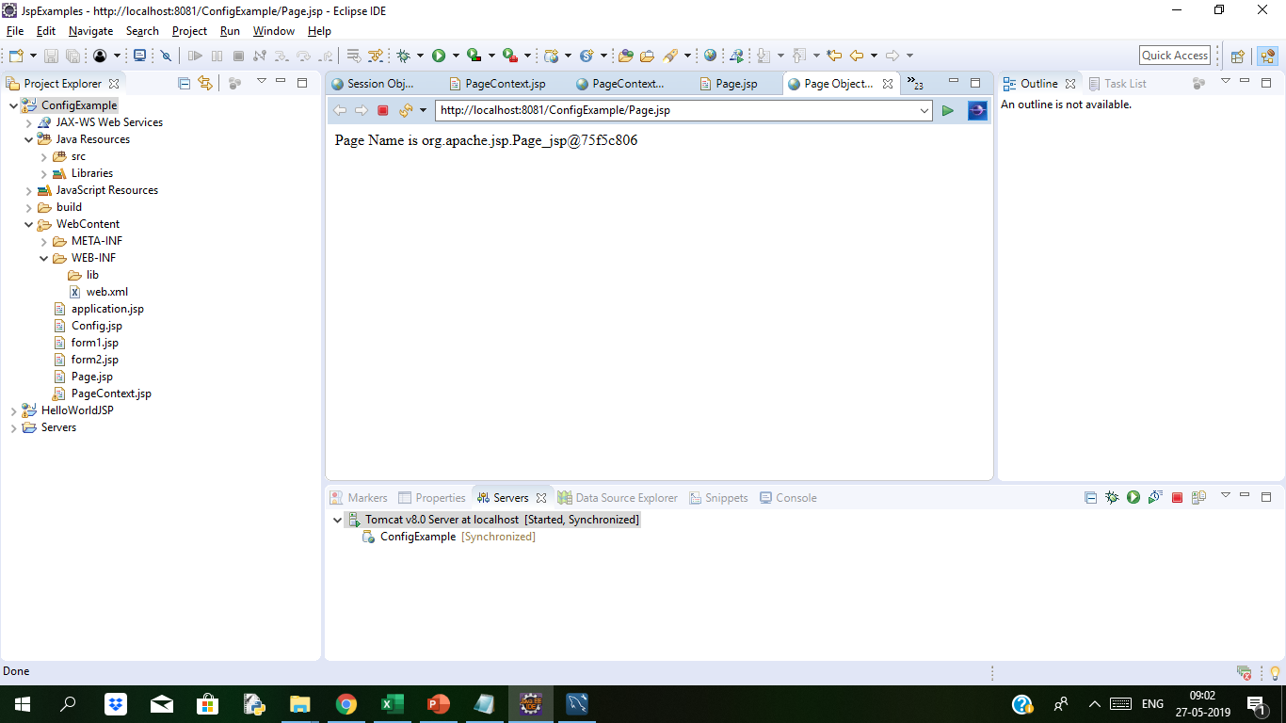
JSP Page Object Example Duration: 5 min
Page
Page implicit variable holds the currently executed servlet object for the corresponding jsp.
Acts as this object for current jsp page..
We will understand now how this Page object works with example
In this example, we are trying to use the method toString() of the page object and trying to get the string name of theJSP Page.
When you execute the code you get the following output:
Output is string name of above jsp page
Page Name is org.apache.jsp.Page_jsp@75f5c806
<%@ page language="java" contentType="text/html; charset=ISO-8859-1"
pageEncoding="ISO-8859-1"%>
<!DOCTYPE html PUBLIC "-//W3C//DTD HTML 4.01 Transitional//EN" "http://www.w3.org/TR/html4/loose.dtd">
<html>
<head>
<meta http-equiv="Content-Type" content="text/html; charset=ISO-8859-1">
<title>Page Object Example</title>
</head>
<body>
<% String pageName = page.toString();
out.println("Page Name is " +pageName);%>
</body>
</html>

Slide 21
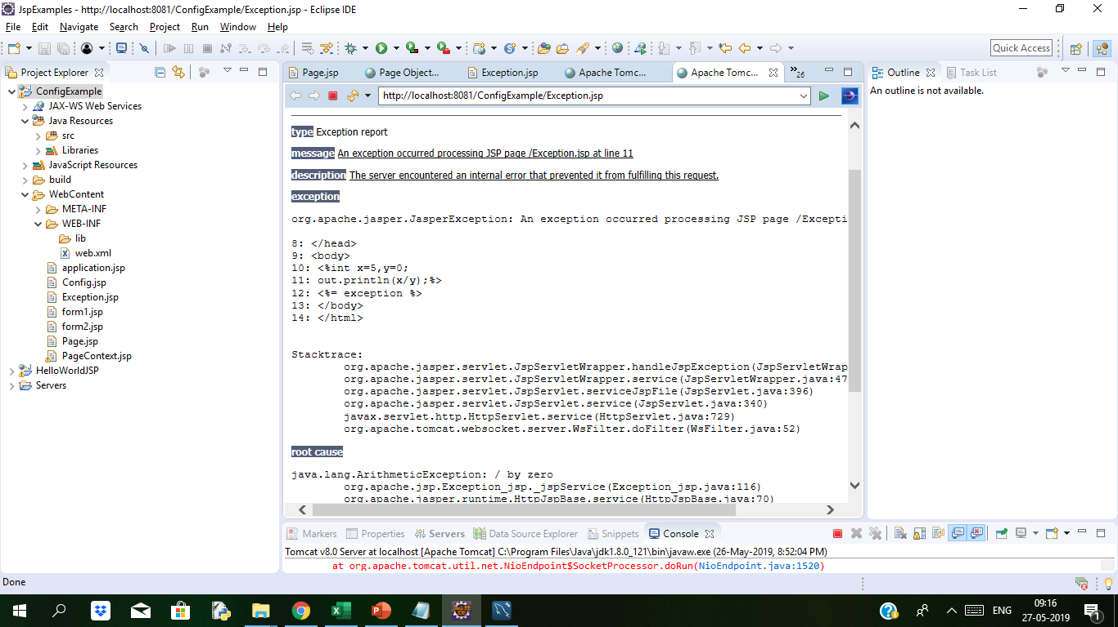
JSP Exception Example Duration: 7min
Exception
Exception is the implicit object of the throwable class.
It is used for exception handling in JSP.
The exception object can be only used in error pages.
We will see the example to elaborate more about exception.
In the below example if we divide by 0 the exception division by zero excpetion is thrown.
Line <%= exception %> is throwing exception
<%@ page language="java" contentType="text/html; charset=ISO-8859-1"
pageEncoding="ISO-8859-1" isErrorPage="true"%>
<!DOCTYPE html PUBLIC "-//W3C//DTD HTML 4.01 Transitional//EN" "http://www.w3.org/TR/html4/loose.dtd">
<html>
<head>
<meta http-equiv="Content-Type" content="text/html; charset=ISO-8859-1">
<title>Exception Example</title>
</head>
<body>
<%int x=5,y=0;
out.println(x/y);%>
<%= exception %>
</body>
</html>

Slide 22
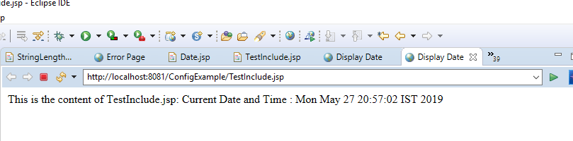
JSP include directive Example Duration:10 min
include Directive
The JSP include directive allows you to include the content of a web page in the current web page. The location where you insert the include directive in a web page is very important because it is at that specific location where the content of a web page is added in the current web page.
Syntax of include Directive
<%@ include file = " banner.html " %>
include Directive Example
We have created a JSP web page that displays the current day, date and time, as shown below.
we have created a web page that uses include directive to include the contents of a web page Date.jsp(which displays the current date and time) at a particular location of the current web page.
After running the TestInclude.jsp on browser we will see the output as below.
Date.jsp
<html>
<head>
<title>Display Date</title>
</head>
<body>
<%@page import="java.util.*" %>
Current Date and Time : <%= new Date() %>
</body>
</html>
TestInclude.jsp
<html>
<head>
<title>Display Date</title>
</head>
<body>
This is the content of TestInclude.jsp Page
<%@ include file="Date.jsp" %>
</body>
</html>

Slide 23
JSP taglib directive
Taglib Directive
The taglib directive is used to define tag library that the current JSP page uses. A JSP page might include several tag library. JavaServer Pages Standard Tag Library (JSTL), is a collection of useful JSP tags, which provides many commonly used core functionalities. It has support for many general, structural tasks such as iteration and conditionals, readymade tags for manipulating XML documents, internationalization tags, and for performing SQL operations.
Syntax of taglib directive is:
<%@ taglib prefix="prefixOfTag" uri="uriOfTagLibrary" %>
The prefix is used to distinguish the custom tag from other library custom tag. Prefix is prepended to the custom tag name. Every custom tag must have a prefix.
The URI is the unique name for Tag Library.
You can name the prefix anything, but it should be unique.
To use the JSTL in your application you must have the jstl.jar in your webapps /WEB-INF/lib directory. Download the jar file from page.
There are many readymade JST Libraries available which you use to make your life easier. Following is a broad division on different groups of JST libraries :
Core Tags - URI → http://java.sun.com/jsp/jstl/core
Formatting Tags - URI → http://java.sun.com/jsp/jstl/fmt
SQL Tags - URI → http://java.sun.com/jsp/jstl/sql
XML Tags - URI → http://java.sun.com/jsp/jstl/xml
JSTL Functions - URI → http://java.sun.com/jsp/jstl/functions
Notes:
We will see taglib directive when we will see custom tags examples

Slide 24

Thank You

